Slide 1

Note: The data and information in this document is reflective of a hypothetical situation and client. This document is to be used for KPMG Virtual Internship purposes only.
Sprocket Central Pty Ltd
Data analytics approach
Engineering Analytics Department– Manish Rawat

Slide 2
Note: The data and information in this document is reflective of a hypothetical situation and client. This document is to be used for KPMG Virtual Internship purposes only.
Agenda
Introduction
Data Exploration/Model Development
Interpretation

Slide 3

Note: The data and information in this document is reflective of a hypothetical situation and client. This document is to be used for KPMG Virtual Internship purposes only.
Introduction
For context, Sprocket Central Pty Ltd is a long-standing KPMG client whom specializes in high-quality bikes and accessible cycling accessories to riders. Their marketing team is looking to boost business by analyzing their existing customer dataset to determine customer trends and behavior.
Using the existing 3 datasets (Customer demographic, customer address and transactions) as a labelled dataset, please recommend which of these 1000 new customers should be targeted to drive the most value for the organization.
In building this recommendation, we need to start with a PowerPoint presentation which outlines the approach which we will be taking. The client has agreed on a 3 week scope with the following 3 phases as follows - Data Exploration; Model Development and Interpretation.
Prepare a detailed approach for completing the analysis including activities – i.e. understanding the data distributions, feature engineering, data transformations, modelling, results interpretation and reporting. This detailed plan needs to be presented to the client to get a sign-off. Please advise what steps you would take.

Slide 4
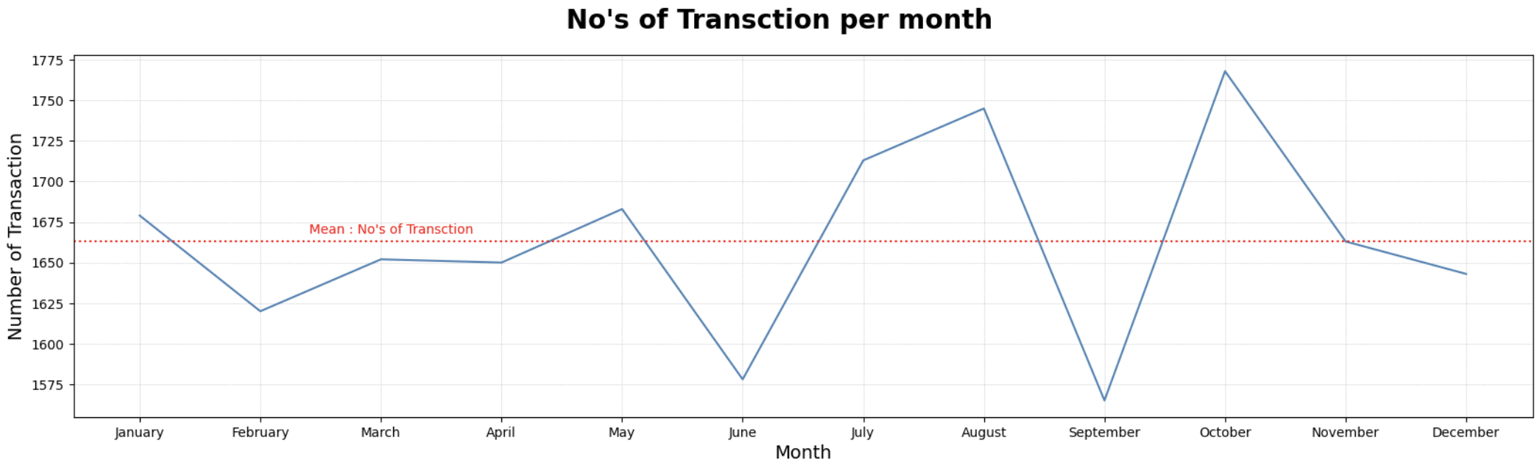
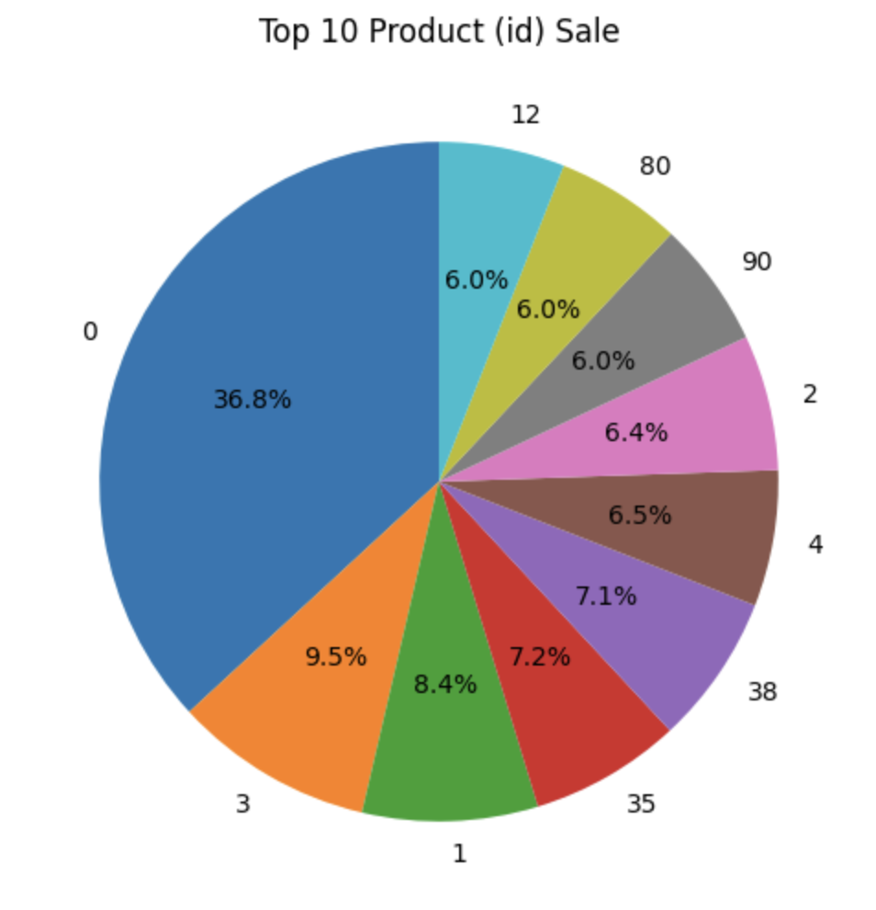
Note: The data and information in this document is reflective of a hypothetical situation and client. This document is to be used for KPMG Virtual Internship purposes only.
Data Exploration

Slide 5
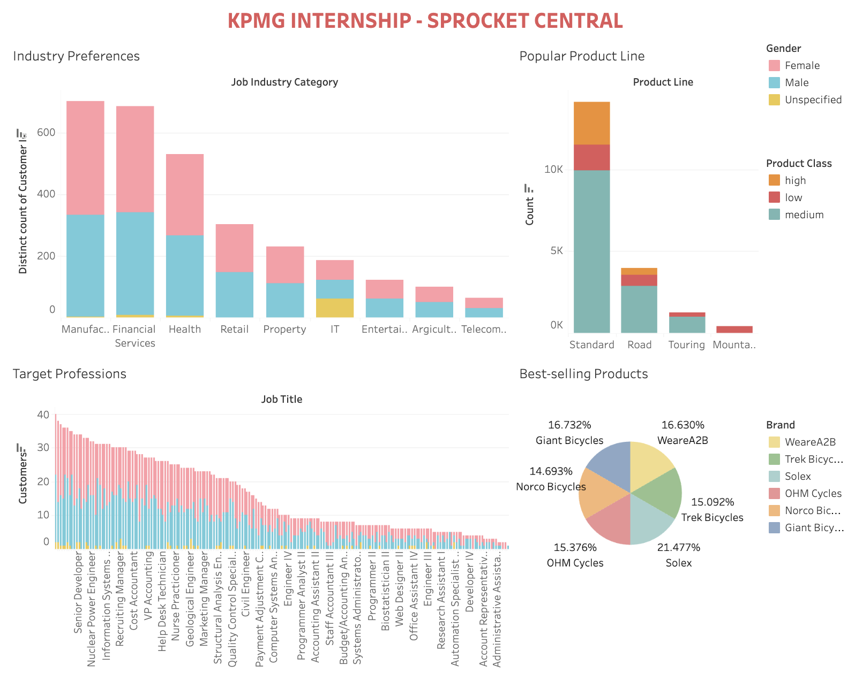
Note: The data and information in this document is reflective of a hypothetical situation and client. This document is to be used for KPMG Virtual Internship purposes only.
Data Exploration
Dashboard Link

Slide 6
Note: The data and information in this document is reflective of a hypothetical situation and client. This document is to be used for KPMG Virtual Internship purposes only.
Interpretation
Based on the above analysis, the following key findings and recommendations can be made:- 1. Industry Preferences: The major user segments are observed in the Manufacturing, Financial Services, and Health industries, followed by Retail, Property, and IT domains. To optimize business growth, it is recommended to prioritize these industries in marketing and sales strategies.
2. Targeted Professions: The prime users of the product include individuals working as Social Workers, Business Analysts, Assistant Professors, Legal Assistants, and Executive Secretaries. To capitalize on this trend, it is recommended to focus marketing efforts towards these professional segments.
3. Popular Product Line: The Standard product line exhibits the highest sales with a count of 14,151. This indicates its popularity among customers. To leverage this demand, it is advised to ensure sufficient availability and promotion of Standard products.

Slide 7
Note: The data and information in this document is reflective of a hypothetical situation and client. This document is to be used for KPMG Virtual Internship purposes only.
Interpretation
4. Best-selling Products: The most sold products are identified as Product IDs O, 3, and 1. It is recommended to monitor and maintain adequate stock levels of these products to meet customer demand.
5. Geographic Focus: The majority of customers are located in the state of NSW. To maximize market penetration and customer engagement, targeted marketing campaigns and promotional activities should be concentrated in this region.
6. Target Age Group: The analysis reveals that customers in the age group of 40-50 are the primary users of the product. Tailored marketing strategies and product offerings should cater to the preferences and needs of this age group to attract and retain customers.
7. Property Valuation: Customers with property valuations ranging between 7-10.5 demonstrate a higher propensity for purchasing the product. This segment should be targeted with customized offers and incentives to drive sales.

Slide 8
Note: The data and information in this document is reflective of a hypothetical situation and client. This document is to be used for KPMG Virtual Internship purposes only.
Interpretation
8. Brand Performance: The brand with the highest transaction percentage is Solex at 21.48%, followed by Giant Bicycles (16.73%) and WeareA2B (16.63%). To capitalize on the popularity of these brands, marketing efforts should emphasize their unique selling propositions and strengthen brand loyalty.
In conclusion, by considering these recommendations and aligning marketing strategies accordingly, the overall business growth and customer acquisition can be optimized in a more professional and targeted manner.

Slide 9
Note: The data and information in this document is reflective of a hypothetical situation and client. This document is to be used for KPMG Virtual Internship purposes only.
Appendix

Slide 10
Note: The data and information in this document is reflective of a hypothetical situation and client. This document is to be used for KPMG Virtual Internship purposes only.
Appendix
Tableau:
https://www.tableau.com/
2. Tableau Tutorial:
https://www.youtube.com/watch?v=Nr31rv9tsJ8
3. PowerBI: https://powerbi.microsoft.com/en-us/
4. PowerBI Tutorial: https://www.youtube.com/watch?v=e2wDqspleNk
5. EDA: https://www.ibm.com/topics/exploratory-data-analysis

